Slide 1
OPTIMIZING HOSPITALITY
Data-Driven insights into India’s Hotel Economy
Presented By :
Basani Rakesh

Slide 2
Project Objective
The objective of the “Optimizing Hospitality” project is to conduct an in-depth analysis of the pricing, reviews, hotels-name across the India.
To analyze hotels hospitality across India to understand customer preference, price optimization and provide actionable market insights that help improve operations, market strategies, and overall efficiency of hotels across the India.
The data is extracted from “Booking.com” website by web scraping using Beautiful Soup in python

Slide 3
Agenda
Web scraping to collect the data
Data Cleaning and Manipulation
Visualization and Analysis on various factors like Hotel name,
Price ,Reviews ,Rating …..etc to analyze above problem statements
As in-depth exploration of web scraping and data visualization using python and power bi on “ Booking.com ” website.
Made some insights to make improve Operation Easily

Slide 4
Introduction
The project aims to utilize data analytics techniques on a dataset encompassing hotel names, reviews, and pricing information across India. By leveraging Python for data exploration and machine learning, and power bi for interactive data visualization, we will identify key factors influencing hotel price and reviews . The findings will inform in improve operations, market strategics, and overall efficiency of hotels across the country.
This concise introduction highlights:
Project Goal : Analyzing hotels hospitality
key tools : Python and power bi
Focus : Identifying factors like hotel price, reviews and rating
Potential Benefits : Improves operations, market strategics and overall efficiency of hotels

Slide 5
Web scraping
Web scraping is the automated process of extracting data from websites. It involves sending requests to web servers, parsing the HTML content, and extracting the desired information.
This technique is used for various purposes, such as data mining, price comparison, and market research. However, it's important to respect website terms of service and avoid overwhelming servers with excessive requests.
We use Beautiful Soup library to extract data.

Slide 6
Tools used
Software Requirement:
Python(Jupyter notebook)
MS Excel
Power BI
Imported Libraries:
Beautiful Soup
Requests
openpyxl

Slide 7
Flow of Project
IDENTIFY DATA SOURCES
( Used Cars)
EXTRACT THE DATA
(Web Scrape Using Python)
MAP DATA
(Format and Clean Data )
DASHBOARD
(Power Bi)
VISUALIZATION
(Charts)
TRANSFORMING AND LOAD THE DATA

Slide 8
Python code for Web Scraping
Importing Libraries
from bs4 import BeautifulSoup
import requests
import openpyxl
Opening excel Workbook and Activating the Workbook
excelwb = openpyxl.Workbook()
sheet = excelwb.active
sheet.append(["Hotel_name","Ratings","Reviews","Review_count","Price","Room_type"
,"Bed_type","Location","Tax","Distance_from_centralcity"])

Slide 9
URL
headers = {'User-Agent': 'Mozilla/5.0 (Windows NT 10.0; Win64; x64) AppleWebKit/537.36
(KHTML, like Gecko) Chrome/116.0.0.0 Safari/537.36 Edg/116.0.1938.54'}
data = requests.get(r"https://www.booking.com/searchresults.en-gb.html?ss=Ahmedabad%2C+Gujarat%2C+India&ssne=Bangalore&ssne_untouched=Bangalore&label=msn-HiTydpHndf_KligNqm9Sgw-79852220055838%3Atikwd-79852393960302%3Aloc-90%3Aneo%3Amte%3Alp116070%3Adec%3Aqsbooking.com&aid=2369661&lang=en-gb&sb=1&src_elem=sb&src=searchresults&dest_id=-2088270&dest_type=city&ac_position=0&ac_click_type=b&ac_langcode=en&ac_suggestion_list_length=5&search_selected=true&search_pageview_id=54b46154e5a000db&ac_meta=GhA1NGI0NjE1NGU1YTAwMGRiIAAoATICZW46A2FobUAASgBQAA%3D%3D&checkin=2025-01-19&checkout=2025-01-20&group_adults=1&no_rooms=1&group_children=0",headers = headers)
soup = BeautifulSoup(data.text,"html.parser")
Finding the hotels data element
hotels = soup.find("body")\
.find("div",id="bodyconstraint-inner")\
.find("div",attrs={"data-capla-component-boundary":"b-search-web-searchresults/SearchResultsDesktop"})\
.find("div",class_="af5895d4b2")\
.find("div",class_="dcf496a7b9 bb2746aad9")\
.find_all("div",class_="c066246e13 d8aec464ca",attrs={"data-testid":"property-card-container"})

Slide 10
For loop to scrape the data in the given element
for hotel in hotels:
try:
Hotel_name = hotel.find("div",class_="c1edfbabcb")\
.find("div",class_="f6431b446c a15b38c233").text
Ratings = hotel.find("div",class_="c1edfbabcb")\
.find("div",class_="a3b8729ab1 d86cee9b25").find("div",class_="ac4a7896c7").text.split(" ")[1]
Reviews = hotel.find("div",class_="c1edfbabcb")\
.find("div",class_="a3b8729ab1 e6208ee469 cb2cbb3ccb").text
Review_count = hotel.find("div",class_="c1edfbabcb")\
.find("div",class_="abf093bdfe f45d8e4c32 d935416c47").text.split(" ")[0]
Price = hotel.find("div",class_="c1edfbabcb")\
.find("div",class_="b1037148f8 c730b02848")\
.find("span",class_="f6431b446c fbfd7c1165 e84eb96b1f").text
Room_type = hotel.find("div",class_="c1edfbabcb")\
.find("div",class_="b1037148f8 c730b02848")\
.find("h4",class_="abf093bdfe e8f7c070a7").text

Slide 11
Bed_type = hotel.find("div",class_="c1edfbabcb")\
.find("div",class_="b1037148f8 c730b02848")\
.find("div",class_="abf093bdfe").text
Location = hotel.find("div",class_="c1edfbabcb")\
.find("span",class_="aee5343fdb def9bc142a").text
Tax = hotel.find("div",class_="c1edfbabcb")\
.find("div",class_="b1037148f8 c730b02848")\
.find("div",class_="abf093bdfe f45d8e4c32",attrs={"data-testid":"taxes-and-charges"}).text.split(" ")[0]
Distance_from_centralcity = hotel.find("div",class_="c1edfbabcb")\
.find("span",attrs={"data-testid":"distance"}).text.split(" ")[0]
sheet.append([Hotel_name,Ratings,Reviews,Review_count,Price,Room_type,Bed_type,Location,Tax,Distance_from_centralcity])
print(Hotel_name)
except Exception as e:
print(f"An error occurred: {e}")

Slide 12
Data Cleaning and Manipulation
Saving the data in excel file
excelwb.save(r"D:/ahmdata.xlsx")
Remove the rupees symbol in price and tax.
Remove The Blanks.
Adding price and tax as total price.
Group the Same location name to another column Location.

Slide 13
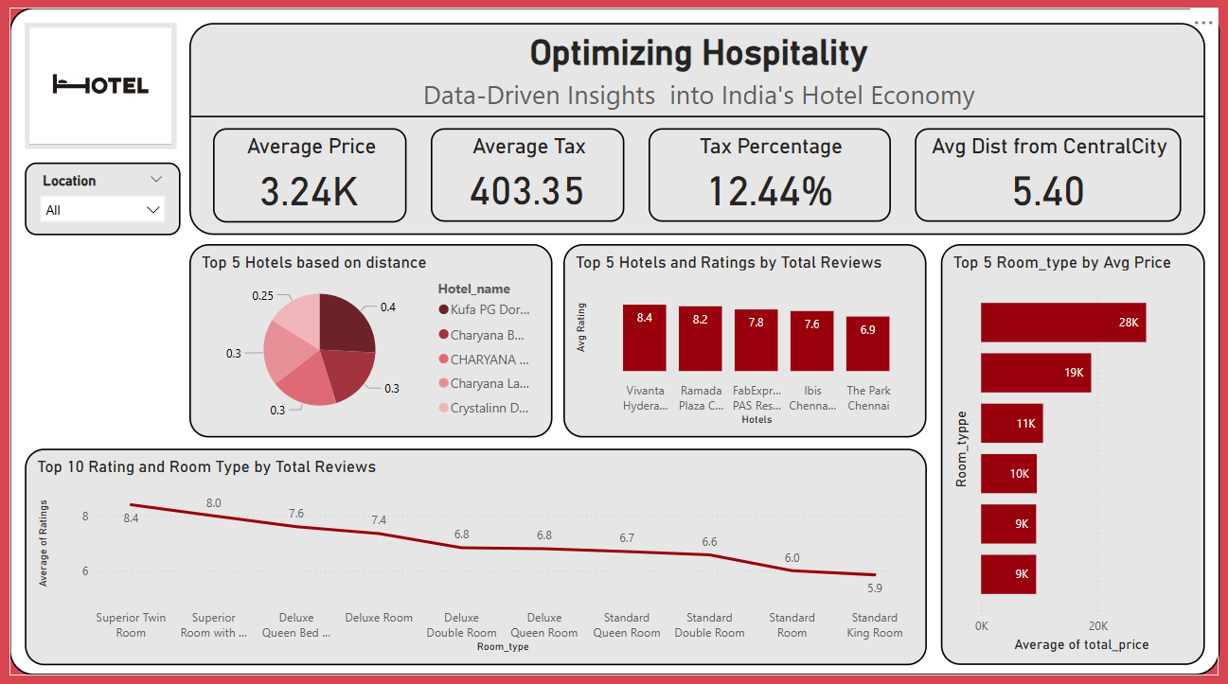
Dashboard

Slide 14
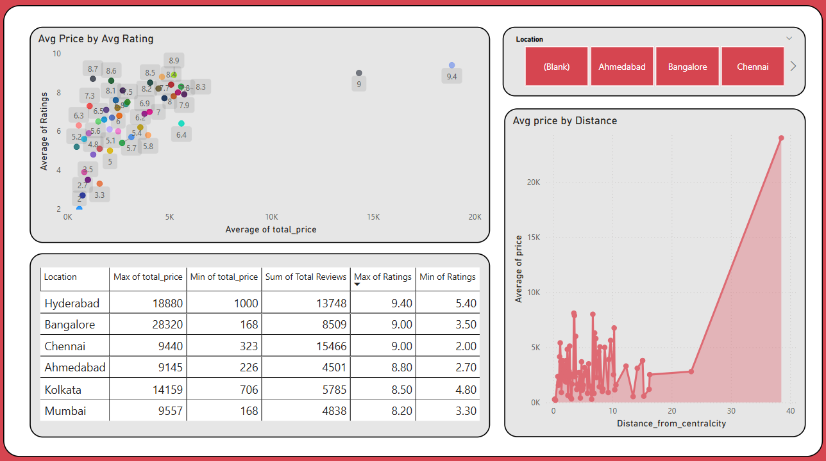

Slide 15
Conclusion
Avg price of hotels in INR= 3,240
Highest avg price by location = Hyderabad (6.03K)
Lowest avg price by location = Ahmedabad (1.94K)
Avg distance from central city in km = 5.4
Max price of hotel and its location = 28,320 (Bangalore)
Min price of hotel and its location = 168 (Bangalore and Mumbai)

Slide 16
Thank you

